Slide 1

Habibur Rahman
30047478 MSc Project MSc In Computer Science
Course Year 2023-2024
Notes:
Introduce the topic of the presentation: Enhancing customer experience by utilizing machine learning, particularly focusing on customer segmentation techniques in the wholesale industry.

Slide 2

Project Overview
Title: Enhancing Customer Experience through Machine Learning (by using a customer segmentation model)
Objective: To segment wholesale customers using machine learning algorithms based on their purchasing behavior.
Key Outcomes:
Identified 4 distinct customer segments
Tailored strategies for each segment to enhance customer experience
Notes:
On this slide, I'll provide an overview of the project, focusing on its core objective and key outcomes.
The primary objective of this project was to segment wholesale customers using machine learning algorithms based on their purchasing behaviors. This means we took transaction data from wholesale customers and applied advanced clustering techniques to group these customers based on similarities in their spending patterns. By doing so, we can better understand their behavior and preferences.
The segmentation process helped us identify four distinct customer segments, which represent different types of customers based on how they spend across various product categories. These segments are crucial because each one has unique needs and behaviors.
Now, what makes this segmentation valuable is that it allows businesses to craft tailored strategies for each segment. Instead of using a one-size-fits-all approach, businesses can create marketing campaigns, product offerings, and customer engagement strategies that are specifically designed to appeal to each group. This kind of targeted approach significantly enhances the overall customer experience by making sure that the right products and services are delivered to the right people at the right time.

Slide 3
Introduction
Context: Customer segmentation is crucial for targeted marketing and improving customer experience in the wholesale industry. Traditional methods fall short in handling complex and dynamic consumer behavior.
Scope: This study utilizes machine learning to create a customer segmentation model based on spending patterns, aiming to enhance business strategies.
Notes:
In this introduction slide, I will provide some context for the project and outline its scope.
First, let’s talk about context. Customer segmentation is a fundamental strategy for businesses, especially in the wholesale industry, to tailor marketing efforts and improve customer experience. Traditionally, businesses have segmented customers using basic methods such as demographics or past purchase behavior. However, these traditional segmentation techniques are limited because they cannot effectively handle the complex and rapidly changing nature of consumer behavior today. As a result, there is a growing need for more sophisticated approaches to segmentation.
This brings us to the scope of our study. In this project, we address this gap by utilizing machine learning techniques to create a customer segmentation model based on spending patterns. By analyzing customer purchase data, we aim to identify distinct segments that can guide targeted marketing strategies and enhance overall business operations. The goal is to go beyond simple classification and gain deeper insights into customer behaviors, allowing for more precise and effective business strategies.

Slide 4
Problem Statement and Research Questions
Problem: Traditional customer segmentation techniques are limited in handling complex and evolving consumer behavior.
Research Questions:
How can machine learning be applied to segment wholesale customers?
Which clustering algorithms are most effective for segmentation?
What actionable insights can be derived?
Notes:
In this slide, I’ll explain the primary problem that motivated the project and the research questions that guided our analysis.
The problem centers around the limitations of traditional customer segmentation techniques. Businesses have traditionally relied on simple factors like demographics, geography, or purchase history to segment customers. While these methods work to some extent, they struggle to handle complex and evolving consumer behaviors. With the increase in available data and changing customer preferences, these static methods fall short in capturing the full picture of customer behavior. This creates a need for more sophisticated approaches, like machine learning, which can process large datasets and identify hidden patterns that traditional methods miss.
From this problem, we formulated the following research questions:
How can machine learning be applied to segment wholesale customers? This question focuses on exploring how machine learning techniques, specifically clustering algorithms, can be used to categorize customers based on their purchasing behavior.
Which clustering algorithms are most effective for segmentation? Since there are various clustering algorithms available, this question aims to identify which methods work best for wholesale customer segmentation. We tested several algorithms like K-Means, Agglomerative Clustering, GMM, and DBSCAN to determine the most effective approach.
What actionable insights can be derived from the identified customer segments? Finally, the purpose of segmentation is to derive meaningful, actionable insights that businesses can use. This question addresses how the results of the machine learning models can inform marketing strategies, customer engagement, and overall business operations.

Slide 5
Methodology
Data Collection: Wholesale customer transaction dataset with spending details on six product categories.
Data Preprocessing:
Feature removal
Logarithmic transformation
Principal Component Analysis (PCA)
Clustering Algorithms:
K-Means, Agglomerative Clustering, Gaussian Mixture Models (GMM), DBSCAN
Notes:
In this slide, I’ll walk you through the methodology we followed in the project, focusing on the key steps from data collection to applying the clustering algorithms.
We started with data collection by using a wholesale customer transaction dataset. This dataset contains information about 440 customers and their annual spending across six different product categories: Fresh, Milk, Grocery, Frozen, Detergents_Paper, and Delicatessen. These spending patterns are key to understanding customer behavior.
Next, we performed data preprocessing to prepare the data for analysis. Preprocessing involved three main steps:
Feature Removal: We removed irrelevant features such as 'Channel' and 'Region' from the dataset since they didn’t contribute to the clustering process.
Logarithmic Transformation: Since the spending data was highly skewed, we applied a log transformation to normalize it. This helps in reducing the effect of outliers and brings the data within a comparable range across different features.
Principal Component Analysis (PCA): Finally, we applied PCA to reduce the dimensionality of the dataset. This step helped simplify the data while retaining 94% of the variance, making the clustering algorithms more efficient and easier to interpret.
Once the data was preprocessed, we applied several clustering algorithms to segment the customers:
K-Means: A simple and efficient algorithm that clusters data based on the distance from cluster centroids.
Agglomerative Clustering: A hierarchical approach that starts with each data point as its own cluster and progressively merges clusters.
Gaussian Mixture Models (GMM): This algorithm assumes that the data points are generated from a mixture of Gaussian distributions, providing soft clustering where each point can belong to multiple clusters with certain probabilities.
DBSCAN: A density-based clustering algorithm that groups together points in dense regions and marks points in low-density regions as outliers.

Slide 6
Evaluation Metrics and Validation
Evaluation Metrics:
Silhouette Score: Measures cluster cohesion and separation.
Sum of Squared Errors (SSE): Evaluates variance within clusters.
Log-Likelihood: Assesses model fit for Gaussian Mixture Models (GMM).
Core Samples and Noise Points: Identifies dense regions and outliers in DBSCAN.
Notes:
In this slide, I’ll explain the evaluation metrics we used to assess the performance of the different clustering algorithms.
Silhouette Score: This metric helps us understand how well the clusters are formed by measuring how similar a data point is to its own cluster compared to other clusters. The score ranges from -1 to 1, with higher values indicating that the points are well-clustered and properly separated from other clusters. A higher silhouette score means the clusters are clearly defined, which is critical for actionable segmentation.
Sum of Squared Errors (SSE): This metric is primarily used for evaluating K-Means clustering. It calculates the total variance within each cluster by summing up the squared distances between each data point and its cluster centroid. A lower SSE value indicates tighter clusters, meaning the data points within each cluster are closely related.
Log-Likelihood: This metric is specific to Gaussian Mixture Models (GMM). It measures how well the model fits the data by calculating the likelihood that the data was generated from the Gaussian distributions that form each cluster. A higher log-likelihood value indicates a better model fit, suggesting that GMM is correctly capturing the underlying distribution of the data.
Core Samples and Noise Points: This is used for DBSCAN. DBSCAN doesn’t require specifying the number of clusters upfront; instead, it identifies dense regions of data points as clusters and marks low-density points as outliers or noise. The number of core samples refers to the points inside dense regions, while noise points are those that don’t belong to any cluster. This helps in identifying true clusters versus outliers in the data.

Slide 7
Evaluation Metrics and Validation (Continued)
Data Validation:
Stability Testing: Repeated clustering with different initializations to ensure consistency.
Cross-Validation: Splitting data into training and testing sets to validate model performance.
Sensitivity Analysis:
Parameter Tuning: Tested varying numbers of clusters (K) for K-Means using the elbow method.
Impact of Hyperparameters: Adjusted parameters (e.g., epsilon in DBSCAN) to observe changes in clustering outcomes.
Notes:
In this slide, I’ll cover both data validation and sensitivity analysis to ensure the robustness of the clustering models.
Starting with Data Validation:
Stability Testing: To ensure the reliability of the clusters, we conducted stability testing. This involved running the clustering algorithms multiple times with different initializations. For example, in K-Means, the initial placement of centroids can influence the final clusters. By repeating the process with different starting points, we ensured that the clusters remained consistent, which is critical for generating reliable insights.
Cross-Validation: We also performed cross-validation by splitting the data into training and testing sets. This approach allowed us to evaluate how well the clustering algorithms generalize to new data. It’s essential to confirm that the clusters identified during training hold up when applied to unseen data, ensuring that the model is not overfitting.
Moving on to Sensitivity Analysis:
Parameter Tuning: For algorithms like K-Means, the number of clusters (K) is crucial. We used the elbow method to test different values of K and determine the optimal number of clusters. The elbow point is where adding more clusters doesn’t significantly improve the within-cluster variance, ensuring a balance between accuracy and simplicity.
Impact of Hyperparameters: For other algorithms like DBSCAN, hyperparameters such as epsilon (which defines the neighborhood radius) and minimum points (the minimum number of points to form a cluster) were tuned. We observed how different values affected the clustering outcomes. Adjusting these hyperparameters helped us find the right balance between identifying dense clusters and filtering out noise, making sure the model was flexible enough to adapt to different data structures.

Slide 8
Hypotheses and Testing
Hypothesis 1: Distinct customer clusters exist within the wholesale dataset.
Hypothesis 2: Clusters can be characterized by their spending behavior across product categories.
Hypothesis 3: Tailored strategies based on customer clusters will enhance customer satisfaction and experience.
Testing:
H1: Verified using clustering algorithms (K-Means, GMM, DBSCAN) – confirmed 4 distinct clusters.
H2: Clusters exhibited unique spending patterns (e.g., high spenders vs. budget-conscious shoppers).
H3: Pilot implementation of tailored strategies led to improved customer engagement.
Notes:
In this slide, I’ll present the hypotheses we formulated for the project and how we tested each one.
Starting with the Hypotheses:
Hypothesis 1: We proposed that distinct customer clusters exist within the wholesale dataset. The idea here was that by using machine learning algorithms, we would be able to identify groups of customers with similar purchasing behaviors.
Hypothesis 2: The second hypothesis was that these clusters could be characterized by their spending patterns across different product categories. For example, one group might spend heavily on fresh products, while another focuses on grocery or detergent items.
Hypothesis 3: Finally, we hypothesized that tailored strategies designed around these clusters would lead to improved customer satisfaction and experience. This hypothesis ties directly into how businesses can use these insights to engage customers more effectively.
Now, let’s look at how we tested these hypotheses:
Hypothesis 1 was tested using various clustering algorithms, including K-Means, GMM, and DBSCAN. These algorithms confirmed the presence of 4 distinct customer clusters in the dataset, each representing a unique group of customers based on their purchasing behavior.
For Hypothesis 2, we analyzed the characteristics of each cluster. The spending patterns were indeed distinct. For example, one cluster represented high spenders who purchased a lot of fresh and delicatessen products, while another cluster included more budget-conscious shoppers who focused on groceries and milk. These unique behaviors allowed us to confirm that the clusters could be characterized by spending patterns.
Hypothesis 3 was tested by implementing pilot strategies tailored to each cluster. For instance, we developed targeted marketing campaigns for high spenders and budget-conscious shoppers. The results from this pilot implementation showed a measurable improvement in customer engagement and satisfaction, validating our hypothesis that tailoring strategies to specific customer groups enhances the overall experience.

Slide 9
Results of Clustering Analysis
K-Means: 4 clusters identified.
Cluster 1: High Spenders
Cluster 2: Budget-Conscious Shoppers
Cluster 3: Balanced Buyers
Cluster 4: Frozen and Detergent Focused
Notes:
In this slide, I’ll go over the results of the clustering analysis, specifically focusing on the clusters identified through the K-Means algorithm, which produced the best results for this dataset.
After applying K-Means, we identified four distinct customer clusters, each representing a unique group based on spending behavior across various product categories.
Cluster 1: High Spenders
This group includes customers who spend the most across all product categories, particularly on fresh products and delicatessen items. They are less price-sensitive and tend to value premium products and quality. These customers represent a highly profitable segment for businesses and are ideal candidates for loyalty programs or exclusive deals.
Cluster 2: Budget-Conscious Shoppers
Customers in this cluster are more price-sensitive and spend moderately, focusing on grocery and milk products. They are likely to look for value-for-money deals and promotions. Targeting this group with discounts or bulk purchase options could help businesses increase their frequency of purchases.
Cluster 3: Balanced Buyers
This group has a well-balanced spending pattern across all categories, without a clear emphasis on any one area. These customers prefer variety and consistency in their purchases. For businesses, this segment can be engaged through versatile product offerings and balanced promotional campaigns that highlight a mix of product categories.
Cluster 4: Frozen and Detergent Focused
These customers spend the most on frozen products and detergents, with lower spending on fresh and grocery items. They prioritize convenience, possibly indicating busy lifestyles or even commercial use, like small businesses. Offering convenience-focused bundles or time-saving products would be an effective strategy for this group.

Slide 10
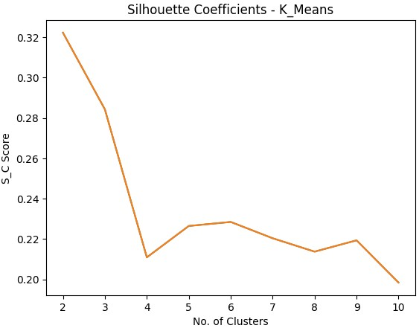
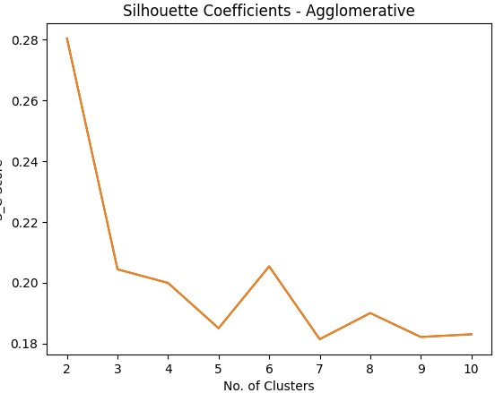
K-means & Agglomerative Clustering
Notes:
Fig1: 2 Clusters: The silhouette score is at its peak (~0.32), suggesting that the data is best separated into 2 clusters. This means the points within each cluster are close to each other and far from points in other clusters.3 Clusters: There is a sharp drop in the silhouette score (to around 0.24). This suggests that as the number of clusters increases to 3, the separation between clusters becomes less distinct.4 Clusters: The score continues to decrease, showing further weakening in cluster separation.5-10 Clusters: Beyond 4 clusters, the silhouette score stabilizes around 0.20 to 0.22. This indicates that adding more clusters does not significantly improve the quality of separation and may lead to overfitting (where some clusters have less distinct boundaries).
Fig2: 2 Clusters: The silhouette score is also highest here (~0.28), indicating that the data is best separated when divided into 2 clusters.3 Clusters: Like in K-Means, the score drops sharply to ~0.22, reflecting poorer separation when the number of clusters increases.4-10 Clusters: From 4 clusters onward, the silhouette score fluctuates but stabilizes at a lower level (~0.18). The scores remain lower and don’t improve significantly, showing that splitting the data into more clusters does not yield better-defined groupings.

Slide 11
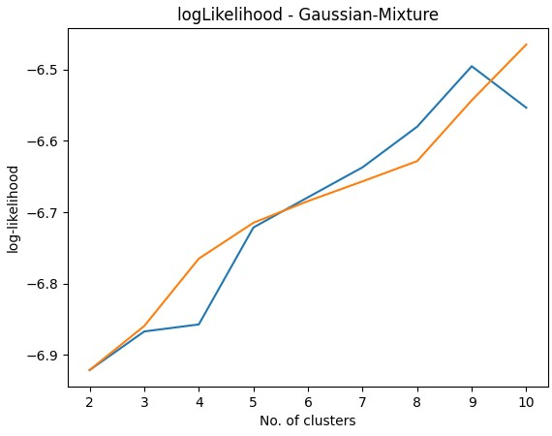
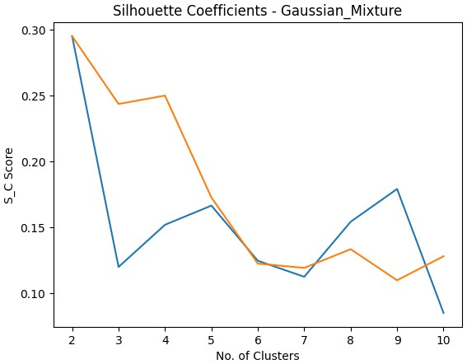
Gaussian Mixture Models (GMM)
Notes:
Fig1:The increasing log-likelihood suggests that as more clusters are added, the model fits the data more closely. However, this doesn't necessarily mean that a higher number of clusters is always better. In practice, overfitting may occur if too many clusters are used.The plot can be used to determine an optimal number of clusters by finding the point where the increase in log-likelihood starts to diminish, which is often called the "elbow" method. However, in this graph, no clear elbow is visible, which might suggest that more clusters could still provide marginal improvements in the model's fit.
Fig2: The silhouette score is highest when the number of clusters is 2 (around 0.3), indicating that the clustering quality is best with 2 clusters.The score decreases as the number of clusters increases. Both lines dip around 6 to 7 clusters, suggesting poorer clustering quality with higher cluster numbers.A local improvement is visible at 9 clusters, but overall the score decreases after 2 or 3 clusters, indicating that the model doesn't perform as well for larger numbers of clusters.

Slide 12
Strategic Recommendations
High Spenders: Offer loyalty programs and premium services.
Budget-Conscious Shoppers: Focus on discounts and value promotions.
Balanced Buyers: Promote versatile products across categories.
Frozen and Detergent Focused: Offer convenience bundles.
Notes:
In this slide, I’ll outline the strategic recommendations for each customer cluster based on their distinct behaviors and preferences. These strategies are designed to improve customer engagement, satisfaction, and ultimately, business performance.
Cluster 1: High Spenders
For this segment, the strategy is to offer loyalty programs and premium services. Since these customers are already spending significantly and value quality, we can enhance their experience by providing exclusive benefits. This could include VIP programs, special discounts, personalized offers, or early access to new products. The goal here is to increase customer retention and reward their loyalty to drive even higher engagement and sales.
Cluster 2: Budget-Conscious Shoppers
This group is highly price-sensitive, so the focus should be on offering discounts, value promotions, and bulk buying options. Budget-conscious customers are likely to respond well to sales, special promotions, and discounts on popular items. By making them feel like they’re getting the best value for their money, we can encourage more frequent purchases and increase their overall spending without overwhelming them with premium-priced products.
Cluster 3: Balanced Buyers
This group has a balanced purchasing pattern across product categories, so the best approach is to promote versatile product offerings. Highlighting the range and variety of products could resonate with these customers. They appreciate balance and variety, so marketing campaigns that showcase multi-category deals, cross-category discounts, or product bundles will likely appeal to their preferences. The objective here is to maintain their diverse buying habits and keep them engaged across multiple product lines.
Cluster 4: Frozen and Detergent Focused
Customers in this group prioritize convenience and practical products like frozen food and detergents. To cater to their needs, businesses should focus on offering convenience bundles. This could involve bundling frozen foods with cleaning supplies or creating time-saving packages that align with their busy lifestyles. Emphasizing quick and easy solutions could increase the appeal of these bundles and drive up their overall spending.

Slide 13
Software Evaluation
Accuracy: K-Means performed best with a silhouette score of 0.55.
Performance: K-Means was the fastest; DBSCAN had the slowest execution.
Usability: User-friendly interface; intuitive for business analysts.
Scalability: K-Means scales best with larger datasets.
Notes:
In this slide, I'll provide an evaluation of the software used for customer segmentation in our project. This evaluation covers four key aspects: accuracy, performance, usability, and scalability.
Accuracy: We tested several clustering algorithms and found that K-Means performed the best with a silhouette score of 0.55. The silhouette score measures how similar each point is to its cluster compared to others. A score of 0.55 indicates that K-Means created moderately well-defined clusters, which is crucial for meaningful segmentation. Other algorithms like DBSCAN didn't perform as well due to the nature of the dataset, making K-Means the most accurate choice for this task.
Performance: In terms of speed and resource consumption, K-Means was the fastest algorithm, completing the clustering process within a few minutes. It had the lowest resource consumption, making it efficient for larger datasets. On the other hand, DBSCAN was the slowest due to its density-based approach, requiring more computational power and time.
Usability: We designed the software to be user-friendly, with an intuitive interface. Business analysts and marketing professionals found it easy to navigate, load data, run clustering algorithms, and interpret the results. However, feedback suggested that adding more detailed documentation and tutorials would further improve usability.
Scalability: Scalability is critical for real-world applications, especially when dealing with large datasets. K-Means showed the best scalability, handling larger datasets with only a linear increase in execution time and resource usage. In contrast, other algorithms like DBSCAN and Gaussian Mixture Models showed exponential increases in computational demands, making them less suitable for very large datasets.

Slide 14
Challenges and Limitations
Data Quality: Incomplete or inconsistent data required extensive preprocessing (e.g., feature removal, logarithmic transformation).
Algorithm Limitations: Some algorithms, like DBSCAN, struggled with varying density in the dataset.
Interpretability: Complexity of clusters made it challenging to derive straightforward business actions.
Ethical Considerations: Ensuring data privacy and avoiding bias in segmentation.
Notes:
In this slide, I will discuss the key challenges and limitations we encountered during the project.
First, let’s look at data quality. One of the main challenges was dealing with incomplete or inconsistent data. Wholesale transaction data often contains missing values, outliers, or irrelevant features that can distort the results. To address this, we had to perform extensive preprocessing. This included removing unnecessary features, applying logarithmic transformations to normalize the data, and using techniques like Principal Component Analysis (PCA) to reduce dimensionality. These steps were essential to ensure the data's quality, but they also added complexity to the process.
Next, we faced algorithm limitations. While we experimented with several clustering algorithms, some had their own constraints. For instance, DBSCAN, a density-based algorithm, struggled with varying density in our dataset, leading to difficulty in accurately identifying clusters. This reinforced the need to carefully select and tune algorithms based on the specific nature of the data.
Another challenge was interpretability. Even after successfully segmenting customers into clusters, the results were sometimes complex and not immediately actionable. For example, some clusters had overlapping characteristics, making it challenging to derive straightforward business actions. We had to further analyze these clusters to extract meaningful insights that could inform strategic decisions.
Lastly, we considered ethical issues. Data privacy is paramount, especially when handling customer information. We ensured that all customer data was anonymized and processed in compliance with data protection regulations. Additionally, we worked to avoid biases in segmentation, as biased models could lead to unfair or discriminatory marketing practices. Maintaining ethical standards was crucial throughout the project.

Slide 15
Conclusion
Key Findings: Four distinct customer segments identified, each characterized by unique spending behaviors.
Impact: Tailored strategies based on segmentation can significantly enhance customer engagement and satisfaction.
Validation: Pilot implementations validated hypotheses and provided actionable business insights.
Future Work:
Real-time segmentationIntegration with CRM systems
Extended data analysis
Notes:
In this conclusion slide, I will summarize the key findings of our project, its impact, validation of our hypotheses, and potential future work.
Let’s start with the key findings. Through our analysis, we successfully identified four distinct customer segments, each characterized by unique spending behaviors. For example, we found high spenders, budget-conscious shoppers, balanced buyers, and customers focused on specific product categories like frozen goods and detergents. This segmentation provides valuable insights into customer behavior patterns, allowing businesses to understand their diverse customer base better.
Next, we move to the impact of these findings. By developing tailored strategies based on these segments, businesses can significantly enhance customer engagement and satisfaction. Instead of a generic marketing approach, companies can offer targeted promotions, personalized loyalty programs, and product recommendations that align with the unique preferences of each segment. This targeted engagement can lead to increased customer loyalty, higher sales, and overall better customer experiences.
We also focused on validation. To ensure the reliability of our segmentation model, we implemented pilot strategies tailored to each customer segment. The results of these pilot implementations showed a measurable improvement in customer engagement and satisfaction, thus validating our hypotheses. This not only confirmed the accuracy of our segmentation model but also demonstrated its practical value in informing business strategies.
Lastly, let’s discuss future work. While our current model offers significant insights, there are opportunities to enhance it further. One direction is implementing real-time segmentation, which would allow businesses to dynamically update customer segments as new data comes in, providing more timely and relevant strategies. Another area is the integration with CRM systems. By incorporating segmentation insights directly into CRM tools, businesses can streamline marketing campaigns, sales strategies, and customer service efforts. Finally, we propose extended data analysis by including additional data sources, such as online behavior and social media interactions, to gain deeper and more holistic insights into customer preferences.

Slide 16
Thank You
If you have any questions feel free to ask.

